Slide 1
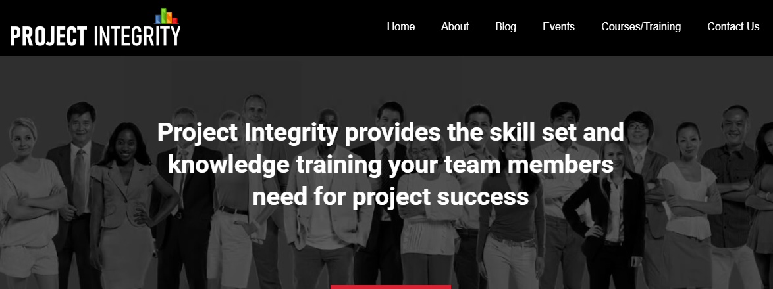
ProjectIntegrity.com
Transform to Full Stack
(React, .Net Core)
[SEPT 11, 2019]

Slide 2
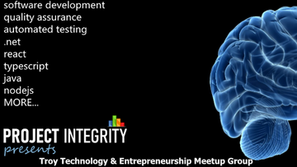
Troy Technology & Entrepreneurship Meetup Group
These are 100% hands-on in-person instructor led (mini) boot camps. RSVP only meetups.
Topics will vary week to week with an emphasis on using technology to enable entrepreneurs.

Slide 3
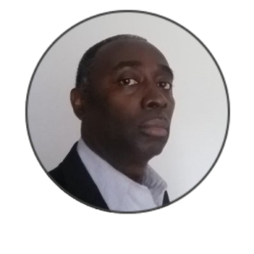
ProjectIntegrity.com
Bond Nwonye (Principal Trainer/Instructor)
Bond is the principal of ProjectIntegrity.com and has over 20 years of IT experience. He has managed the development of ERP systems from design to implementation. Bond is knowledgeable in system analysis and design, has written technical specifications and managed all aspects of development. Bond has also been an Instructor teaching: C#, SQL development and databases.

Slide 4
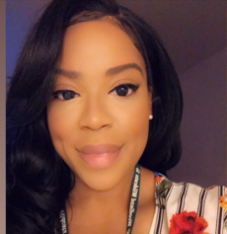
ProjectIntegrity.com
Bernice Cathey (COO – FreemiumMedia.com)
Bernice Cathey is the COO of FreemiumMedia.com and host of the ProjectIntegrity.com meetups.
FreemiumMedia leverages innovative technology to make your brand hyper-local.
FreemiumMedia.com enables small business growth through our digital assets: SwirlMatch.com, BeanDaddy.com, FreemiumAdvertising.com, ShoeDacity.com, Repairfaster.com, FreemiumDelivery.com, Caloricly.com, Incuprise.com and more.

Slide 5
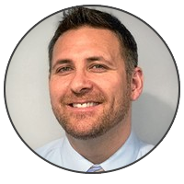
ProjectIntegrity.com
Sean Hogg (Visiting Instructor)
Sean is the VP of Technology for Career Now Brands. He has over 20 yrs of hands on experience leading information technology in all areas. Sean has lead Enterprise, Solutions and Application Architecture Teams and conducts 100% hands on tutoring and training on .net/c#, front end tech, design patterns, data, devops and qa.

Slide 6
ProjectIntegrity.com
Installation of .Net Core 3.0
Installation of NodeJS (React)
Goal: Let's build a Net Application

